Slide 1
Intro to the Theory of Computation
Based on Michael Sipser lectures
Notes:
The number of keywords in a programming language is finite, but the number of programs we can write is infinite.
We can use induction to check whether it is correct or not (by the compiler)

Slide 2






Let’s begin: Finite Automata
0
1
$$M1$$
0,1
1
$$q3$$
$$q1$$
$$q2$$
0
Input: finite string Output: Accept or Reject
Computation process: Begin at start state, read input symbols, follow corresponding transitions, Accept if end with accept state, Reject if not.
Examples: 01101 → Accept 00101 → Reject
$M1$ accepts exactly those strings in $A$ where $A = \{w| w$contains substring $11\}.$
States: $q1 ,q2 ,q3$
Transitions:
Start state:
Accept states:
1
Say that $A$ is the language of $M1$ and that $M1$ recognizes $A$ and that $A = L(M1)$.
Notes:
The character above the arrow in transition is the input. [If I get 1 as input when I am in q1 then I will go it q2].
At least 1 accept state.

Slide 3











Finite Automata – Formal Definition
Defn: A finite automaton $M$ is a 5-tuple $(Q, Σ, δ, q0, F)$
$Q$ finite set of states
$Σ$ finite set of alphabet symbols
$δ$ transition function $δ: Q×Σ → Q$
$q0$ start state
$F$ set of accept states
Example:
$δ (q, a) = r$ means
$$q$$
a
$$r$$
0
$$M1$$
1
0,1
$$q1$$
$$q2$$
1
$$q3$$
0
$M1 = (Q, Σ, δ, q1, F)$
$Q = \{q1, q2, q3\}$
$Σ = \{0, 1\}$
$F = \{q3\}$
$$δ=$$
 | 0 | 1
$$q1$$ | $$q1$$ | $$q2$$
$$q2$$ | $$q1$$ | $$q3$$
$$q3$$ | $$q3$$ | $$q3$$
Notes:
Q: Number of states
$Σ$: Inputs for transitions

Slide 4

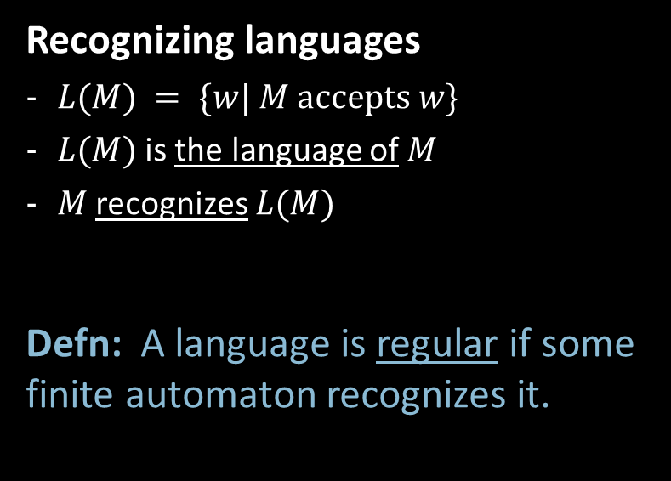
Finite Automata – Computation
Strings and languages
A string is a finite sequence of symbols in $Σ$
A language is a set of strings (finite or infinite)
The empty string ε is the string of length 0 (No symbol)
The empty language (empty set) $ø$ is the set with no strings
{}
Defn: $M$ accepts string $w = w1w2 … wn$each $wi ε Σ$ if there is a sequence of states $r0, r1, r2, ,…, rn ε Q$ where: - $r0 = q0$ - $ri = δ(r_{i−1}, wi)$ for $1≤i≤n$ - $rn ε F$
Recognizing languages
$L(M) = \{w| M accepts w\}$
$L(M)$is the language of $M$
$M$ recognizes $L(M)$
Defn: A language is regular if some finite automaton recognizes it.
Notes:
String: 01100, 10100
Language: {01100, 10110, 11010} -> All accepted string
w = 01100 {w1=0, w2=1, w3=1, w4=0, w5=0}
$wi ε Σ :All inputes must belong to the language$
For any regular language, we can define a finite automata for that.

Slide 5






Regular Languages – Examples
$$M1$$
0
1
0,1
1
$$q3$$
$$q1$$
$$q2$$
0
More examples:
Let $B=\left\{w\right| w$has an even number of 1s$\}$ $B$ is regular (make automaton).
Let $C=\left\{w\right| w$has equal numbers of 0s and 1s$\}$ $C$ is not regular (we will prove).
$L\left(M_{1}\right)= \{w| w contains substring 11\}=A$
Therefore $A$ is regular
Notes:
We cannot count numbers or inputs using regular language.
B = Regular Language
C = Not a regular language

Slide 6


Regular Expressions
Regular operations. Let $A,B$ be languages:
Union: $A∪B=\left\{w\right| w∈A$ or $w∈B\}$
Concatenation: $A∘B=\left\{xy\right| x∈A$ and $y∈B\}=AB$
Star: $A^{∗}=\left\{x_{1}… x_{k}\right|$each$x_{i}∈A$ for $k≥0\}$ Note: $ε∈A^{∗}$ always
Example. Let $A=\{$good, bad$\}$ and $B=\{$boy, girl$\}$.
$A∪B=${good, bad, boy, girl}
$A∘B=AB=$ {goodboy, goodgirl, badboy, badgirl}
$A^{∗}=$ {$ε$, good, bad, goodgood, goodbad, badgood, badbad, goodgoodgood, goodgoodbad, … }
Regular expressions
Built from $Σ$, members $Σ, ∅,ε$
By using $∪, ∘, ∗$
Examples:
${\left(0∪1\right)}^{∗}=Σ^{∗}$ gives all strings over $Σ$
$Σ^{∗}1$ gives all strings that end with 1
$Σ^{∗}11Σ^{∗}=$all strings that contain 11 $=L\left(M_{1}\right)$
Goal: Show finite automata equivalent to regular expressions
Notes:
Deterministic Finite Automate – For each input we know where to go.

